Slide 1

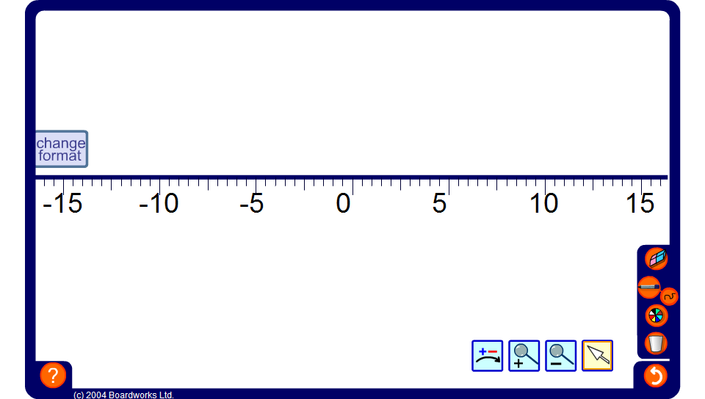


Using a number line
Notes:
Use the interactive number line to demonstrate a variety of addition and subtraction calculations.
Ask volunteers to come to the board to demonstrate solutions to problems using the number line.
Include problems with several small numbers such as 3 – 7 + 1 – –5.

